Slide 1
Pre-Announcements
Maggie works at School of Optometry at Berkeley.
Running Ocular studies and need lots of participants.
Make $20 to $30 hours an hour. Fliers up front.

Slide 2
Announcements
Reminder: Big O vs. Big Theta
Big O is not the same as worst case.
Big Omega is not the same as best case.
Midterm 2:
3/20, 8-10 PM in various rooms.
Covers material through 3/16 (next Friday).
Study using study guides.
THE KEY IS METACOGNITION: Reflect on your problem solving strategies and those of your fellow students.
Understanding a handful of solutions to old midterm problems is less helpful than you might think -- look at answers as late as possible.
There is an alternate 61C midterm from 6 - 8 in 1 LeConte.

Slide 3
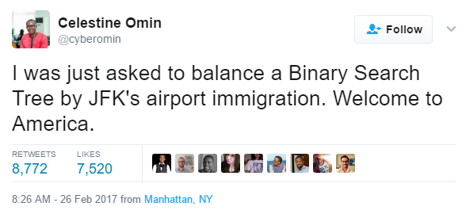
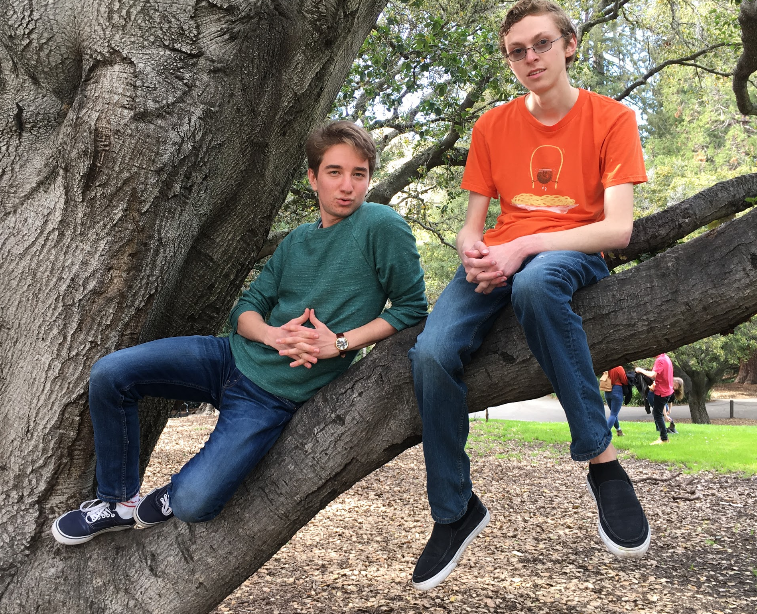
CS61B
Lecture 22: Balanced Search Trees
2-3-4 and 2-3 Trees (a.k.a. B-Trees)
Tree Rotation
Red-Black Trees
Daniel
Ross

Slide 4
The Trouble with Trees
Last time: BSTs have potential performance issue if they get “spindly” (too tall).
Worst case: Items inserted in order.
Fundamental issue: Too lazy about where to store data.
One solution:
Insert in random order.
Results in Θ(log N) height with extremely high probability.
Why don’t we just do this?
m
e
o
b
g
n
p
q
r
s
Notes:
Reason we don’t do this: Don’t have all data in advance. Analogy to use: Imagine keeping a map from the day’s date to a list of things that happened on that day. Obviously can’t add randomly.
Ross: Storing incoming emails, tree sorted by time received. As a teacher, your inbox never stops being flooded.

Slide 5
The Trouble with Trees
Last time: BSTs have potential performance issue if they get “spindly” (too tall).
Worst case: Items inserted in order.
Fundamental issue: Too lazy about where to store data.
One solution:
Insert in random order.
Results in Θ(log N) height with extremely high probability.
Why don’t we just do this?
Might not have all the data up front.
m
e
o
b
g
n
p
q
r
s
Notes:
Reason we don’t do this: Don’t have all data in advance. Analogy to use: Imagine keeping a map from the day’s date to a list of things that happened on that day. Obviously can’t add randomly.
Ross: Storing incoming emails, tree sorted by time received. As a teacher, your inbox never stops being flooded.

Slide 6
Tree Rotation
Notes:
A detour: tree rotation.

Slide 7
Tree Rotation Example
Suppose we have a search tree as shown below:
RotateLeft(G): G moves left, promote its right child in the only natural way.
Promoting P means P is the new parent of G.
Semantics of the tree are completely unchanged!
G
P
B
P
G
r
A
C
k
r
B
k
q
t
j
l
q
t
A
C
j
l
s
s
Result of RotateLeft(G):
Here, rotation reduced height of tree!
To reverse the operation: RotateRight(P)
Notes:
An alternate way of achieving balance.

Slide 8
Another Tree Rotation Example
Suppose we have a search tree as shown below:
RotateRight(P): P moves right, promote its left child in the only natural way.
Try to predict the new shape of the tree.
P
G
r
B
k
q
t
A
C
j
l
s

Slide 9
Another Tree Rotation Example
Suppose we have a search tree as shown below:
RotateRight(P): P moves right, promote its left child in the only natural way.
Try to predict the new shape of the tree.
G
P
P
G
r
r
B
k
q
t
B
k
q
t
A
C
j
l
s
A
C
j
l
s

Slide 10
Another Tree Rotation Example
Suppose we have a search tree as shown below:
RotateRight(P): P moves right, promote its left child in the only natural way.
We see that the operation we did two slides ago has been reversed.
G
P
P
G
r
r
B
k
q
t
B
k
q
t
A
C
j
l
s
A
C
j
l
s
Result of RotateRight(P):
Here, rotation increased height of tree!

Slide 11
Rotation: An Alternate Approach to Balance
Rotation:
Can shorten (or lengthen) a tree.
Preserves search tree property.
B
D
rotateRight(D)
D
B
>D
>D
rotateLeft(B)
< B
> B and < D
< B
> B and < D
Can use rotation to balance a BST: Demo
Non-obvious fact: Rotation allows balancing of any BST.

Slide 12
Rotation: An Alternate Approach to Balance
Rotation:
Can shorten (or lengthen) a tree.
Preserves search tree property.
D
rotateRight(D)
B
B
D
>D
rotateLeft(B)
< A
> B and < D
< A
> B and < D
>D
One way to achieve balance:
Rotate after each insertion and deletion to maintain balance.
… the mystery is to know which rotations. We’ll come back to this.

Slide 13
B-trees / 2-3 trees / 2-3-4 trees
Notes:
A detour: tree rotation.

Slide 14
Search Trees
There are many types of search trees:
Binary search trees: Require rotations to maintain balance. There are many strategies for rotation (AVL, weight-balancing, red-black).
Treaps.
Splay trees.
2-3 / 2-3-4 trees / B-trees: No rotations required.
We’ll develop this idea together in the following slides.
Intriguingly, a deep understanding of 2-3 trees also provides a rotation strategy for BSTs called “red-black”.
Notes:
not adding new leaves doesn’t mean we can’t add new data.

Slide 15
A Weirder Solution
The problem is adding new leaves. Could balance with rotation but it’s not obvious which rotations to perform.
Weirder solution: Never add new leaves.
Tree can never get imbalanced.
m
e
o
b
g
n
p
Q: What do we do with incoming keys?
?
?
r
?
q
?
s
Notes:
not adding new leaves doesn’t mean we can’t add new data.

Slide 16
A Weirder Solution
The problem is adding new leaves. Could balance with rotation but it’s not obvious which rotations to perform.
m
Weirder solution: Overstuff the leaf nodes.
“Overstuffed tree” always has balanced height, because leaf depths never change.
Height is just max(depth).
e
o
b
g
n
p
m
m
e
o
e
o
b
g
n
p q
b
g
n
p q r

Slide 17
A Weirder Solution: The “Overstuffed Tree”
This is a logically consistent but very weird data structure.
contains(r):
Search for the appropriate leaf.
Search the leaf for ‘r’
Q: What is the problem with this idea?
m
e
o
b
g
n
p q r s
m
e
o
a b c d
g h
n
p q r s t u v w x y z 1 2 3 4 ...

Slide 18
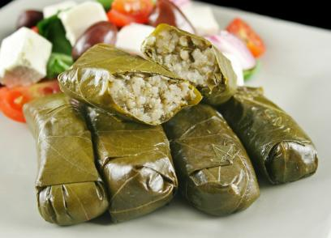
Revising Our Overstuffed Tree Approach
New problem:
Leaf nodes can get too juicy.
m
Q: Solution?
Goal: Still want no new leaf nodes.
e
o
b
g
n
p q r s

Slide 19
Revising Our Overstuffed Tree Approach
New problem:
Leaf nodes can get too juicy.
Solution?
Set a cap on the number of items, say 3.
If more than cap, give an item to parent.
Which one? Let’s say the left-middle.
m
e
o
b
g
n
p q r s
m
Q: What’s the problem now?
Items between o and q have no home.
e
o q
b
g
n
p r s
Notes:
Trying to find p in this. Compare to m? Right. Compare to oq? ????
Ross:

Slide 20
Revising Our Overstuffed Tree Approach
New problem:
Leaf nodes can get too juicy.
Solution?
Set a cap on the number of items, say 3.
If more than cap, give an item to parent.
Which one? Let’s say the left-middle.
m
e
o
b
g
n
p q r s
m
Challenge for you:
How can we tweak this idea to make it work?
e
o q
b
g
n
p r s

Slide 21
Revising Our Overstuffed Tree Approach [your answer]
New problem:
Leaf nodes can get too juicy.
Solution?
Set a cap on the number of items, say 3.
If more than cap, give an item to parent.
Which one? Let’s say the left-middle.
m
e
o
b
g
n
p q r s
m
Challenge for you:
How can we tweak this idea to make it work?
e
o q
b
g
n
p r s

Slide 22
Revising Our Overstuffed Tree Approach: Node Splitting
New problem:
Leaf nodes can get too juicy.
Solution?
Set a cap on the number of items, say 3.
If more than cap, give an item to parent.
Pulling item out of juicy node splits it into left and right.
Parent node now has three children!
m
e
o
b
g
n
p q r s
m
e
o q
b
g
n
p
r s

Slide 23
Revising Our Overstuffed Tree Approach: Node Splitting
This is a logically consistent and not so weird data structure.
contains(r):
r > m, so go right
r > o, so compare vs. q
r > q, so go right
Examining a node might cost us Z compares, but that’s OK since Z is capped. (where Z is the # of items in a node)
What if a non-leaf node gets overstuffed? Can we split that?
Sure, we’ll do this in a few slides, but first...
m
e
o q
b
g
n
p
r s

Slide 24
Insertion Understanding Check
Suppose we insert t, u:
m
m
e
o q
e
o q
b
g
n
p
r s
b
g
n
p
r s t u
Q: If our cap is at most 3 items per node, draw post-split tree:

Slide 25
Insertion Understanding Check
Suppose we insert t, u:
m
m
e
o q
e
o q
b
g
n
p
r s
b
g
n
p
r s t u
Q: If our cap is at most 3 items per node, draw post-split tree:
Is there some send up / send down variant that is useful?
Unknown, but more complicated.
m
e
o q s
b
g
n
p
r
t u

Slide 26
Insertion: Chain Reaction
Suppose we insert y, z:
m
m
e
o q s
e
o q s
b
g
n
p
r
t u
b
g
n
p
r
t u y z
m
m q
e
o q s u
e
o
s u
b
g
n
p
r
t
y z
b
g
n
p
r
t
y z
Notes:
Inserting o: 30 seconds

Slide 27
What Happens If The Root Is Maxed Out on Juice?
m q
m q
m q u
e
o
s u
e
o
s u v w
e
o
s
v w
m q u
m q u w
e
o
s
v w x y
e
o
s
v
x y
Challenge: Draw the tree after the root is split.

Slide 28
What Happens If The Root Is Maxed Out on Juice?
m q u
m q u w
e
o
s
v w x y
e
o
s
v
x y
Challenge: Draw the tree after the root is split.
q
m
u w
e
o
s
v
x y

Slide 29
Perfect Balance
Observation: Splitting-trees have perfect balance.
If we split the root, every node gets pushed down by exactly one level.
If we split a leaf node or internal node, the height doesn’t change.
Bottom line: All operations have guaranteed Θ(log N) time.
More details on next slide.
q
m
u w
e
o
s
v
x y
Notes:
Does this tree look like you’d be impaled by it? Or would you be safe?

Slide 30
Perfect Balance and Logarithmic Height
M: Max number of children (one more than the item cap).
Height: Between log_{M}(N) and log₂(N)
Max number of splitting operations per insert: ~H
Time per insert/contains: Θ(H), or equivalently Θ(log N)
m q
m q
e
o
s u w
e
o
s u
b
g
n
p
r
t
v
y z
b
g
n
p
r
t
v
For M = 4: Max 3 items per node.
Max 4 non-null children per node.
For M = 3: Max 2 items per node.
Max 3 non-null children per node.

Slide 31
The Real Name for Splitting Trees is “B Trees”
Splitting tree is a better name, but I didn’t invent them, so we’re stuck with their real name: B-trees.
A B-tree of order M=4 (like we used today) is also called a 2-3-4 tree or a 2-4 tree.
The name refers to the number of children that a node can have, e.g. a 2-3-4 tree node may have 2, 3, or 4 children.
A B-tree of order M=3 (like in the textbook) is also called a 2-3 tree.
The origin of "B-tree" has never been explained by the authors. As we shall see, "balanced," "broad," or "bushy" might apply. Others suggest that the "B" stands for Boeing. Because of his contributions, however, it seems appropriate to think of B-trees as "Bayer"-trees.
- Douglas Corner (The Ubiquitous B-Tree)

Slide 32
A note on Terminology
B-Trees are most popular in two specific contexts:
Small M (M=3 or M=4):
Used as a conceptually simple balanced search tree (as today).
M is very large (say thousands).
Used in practice for databases and filesystems (i.e. systems with very large records).
See CS186.
Note: Since the small M tree isn’t practically useful (as we’ll see in a few slides), people usually only use the name B-tree to refer to the very large M case.
Notes:
If general M=4 is so hard, why are large M btrees used?

Slide 33
Red-Black Trees

Slide 34
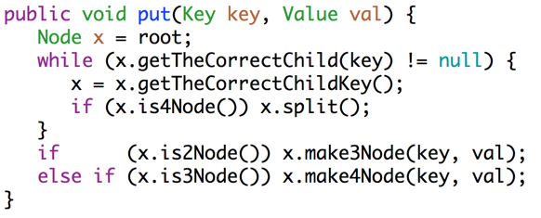
The Bad News
2-3 trees (and 2-3-4 trees) are a real pain to implement, and suffer from performance problems. Issues include:
Maintaining different node types.
Interconversion of nodes between 2-nodes and 3-nodes.
Walking up the tree to split nodes.
“Beautiful algorithms are, unfortunately, not always the most useful” - Knuth

Slide 35
Search Trees
There are many types of search trees:
Binary search trees: Require rotations to maintain balance. There are many strategies for rotation. Coming up with a strategy is hard.
2-3 trees: No rotations required.
Clever (and strange idea): Build a BST that is isometric (structurally identical) to a 2-3 tree.
Use rotations to ensure the isometry.
Since 2-3 trees are balanced, rotations on BST will ensure balance.
Notes:
not adding new leaves doesn’t mean we can’t add new data.

Slide 36
Representing a 2-3 Tree as a BST
A 2-3 tree with only 2 nodes is trivial.
BST is exactly the same!
What do we do about 3 nodes?
m
m
e
o
e
o
b
g
n
p
b
g
n
p
m
????
d f
o
b
e
g
n
p

Slide 37
Representing a 2-3 Tree as a BST: Dealing with 3-Nodes
Possibility 1: Create dummy “glue” nodes.
m
m
d f
o
o
b
e
g
n
p
d
f
n
p
b
e
g
Result is inelegant. Wasted link. Code will be ugly.
d f
d
f

Slide 38
Representing a 2-3 Tree as a BST: Dealing with 3-Nodes
Possibility 2: Create “glue” links with the smaller item off to the left.
m
m
d f
o
f
o
b
e
g
n
p
d
g
n
p
b
e
Idea is commonly used in practice (e.g. java.util.TreeSet).
f
d f
d
For convenience, we’ll mark glue links as “red”.

Slide 39
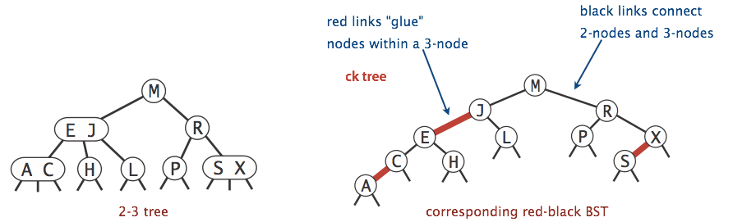
Left-Leaning Red Black Binary Search Tree (LLRB)
Any BST that maintains an isometry with a 2-3 tree has these properties:
No node has two red links (otherwise it’d be like a 4 node).
Every path from root to a leaf has same number of black links.
Red links lean left (idiosyncratic to our textbook), see Red-Black Tree.
Also called a “left leaning red black binary search tree (LLRB)”.
Notes:
I’m asking you to accept a lot of strange abstractions, but I think things will start to make sense with some examples (see remainder of presentation).

Slide 40
Left-Leaning Red Black Binary Search Tree (LLRB)
Draw the LLRB corresponding to the 2-3 tree shown below.
u w
a s
v
x y

Slide 41
Left-Leaning Red Black Tree (LLRB)
Draw the LLRB corresponding to the 2-3 tree shown below.
u w
a s
v
x y
Searching an LLRB tree for a key is easy.
Treat it exactly like any BST.
w
u
y
s
v
x
a

Slide 42
Left-Leaning Red Black Tree (LLRB)
Facts of interest:
For any 2-3 tree (which is balanced), there exists a corresponding red-black tree that has depth no more than 2 times the depth of the 2-3 tree.
With a HUGE dose of cleverness can use rotations to maintain isometry after each insertion and deletion.
Rather advanced topic.
You don’t need to memorize the rules that follow this slide.
w
u w
u
y
a s
v
x y
s
v
x
a

Slide 43
Maintaining Isometry Through Rotations (Optional)

Slide 44
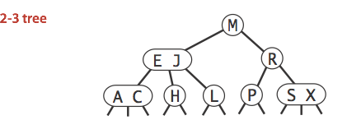
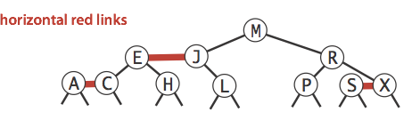
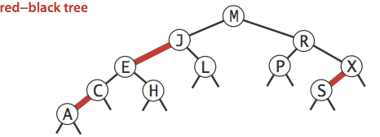
The Isometry
There exists an isometry between:
2-3 Tree
LLRB
Implementation of an LLRB is based on maintaining this isometry.
When performing LLRB operations, pretend like you’re a 2-3 tree.
Preservation of isometry will involve tree rotations.

Slide 45
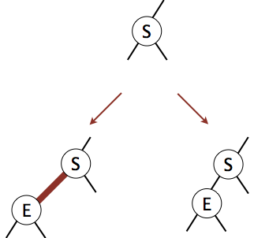

Isometry Maintenance
Should we use a red or black link when inserting?

Slide 46
Isometry Maintenance
Should we use a red or black link when inserting?
Use red! In 2-3 trees we ALWAYS start by increasing node size.

Slide 47
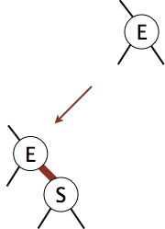

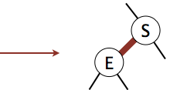
Isometry Maintenance (Non-Trivial Case 1: Right-Insert)
Suppose we have leaf E, and insert S with a red link. What is the problem below?
How do we fix this?
Swap roles of S and E, i.e. rotateLeft(E).

Slide 48
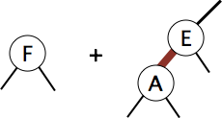
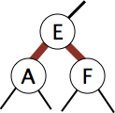
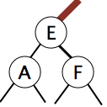
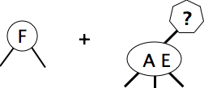
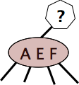
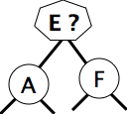
Isometry Maintenance (Non-Trivial Case 2: Two Red Children)
Suppose we add F to an LLRB tree containing E and A as shown below:
What do we do?
Flip Colors.
WW23TD?
Split.

Slide 49
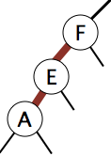
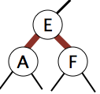
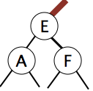
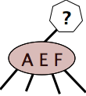
Isometry Maintenance (Non-Trivial Case 3: Two Reds-in-a-Row)
Suppose we add A to E-F. To resolve:
rotateRight(F), putting us back in the two-red-children case.
Then color flip.

Slide 50

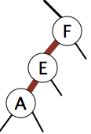
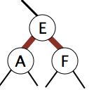
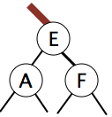
Isometry Maintenance (Case 1 & 3: Left-Red-Right-Red)
Suppose we add E to F-A. To resolve:
rotateLeft(A), putting us back in the two-reds-in-a-row
rotateRight(F), putting us in the two-red children case. Then flip.

Slide 51
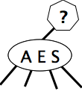
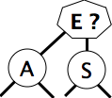
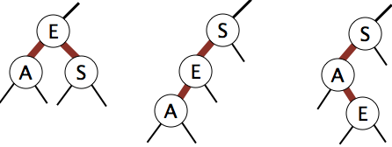
Preserving the Isometry After Addition Operations
Violations for 2-3 trees:
Existence of 4-nodes (bad!)
Operations for Fixing 2-3 Tree Violations:
Splitting a 4-node.
Violations for LLRBs:
Two red children.
Two consecutive red links.
Right red child.
Operations for Fixing LLRB Tree Violations: Tree rotations and Color Flips!

Slide 52
LLRB Performance
In an LLRB, every path from root to a null has same number of black links.
Since 2-3 trees are perfectly balanced, LLRBs are perfectly black balanced. Guaranteed logarithmic performance for insert (see textbook for delete).

Slide 53
Summary
2-3 and 2-3-4 Trees have perfect balance.
Height is guaranteed logarithmic.
After insert/delete, at most 1 split operation per level of the tree.
Since height is logarithmic, we have O(log N) splits.
insert/delete are therefore O(log N).
Hard to implement.
LLRBs mimic 2-3 tree behavior using color flipping (and tree rotation).
Height is guaranteed logarithmic.
After insert/delete, at most 1 color flip or rotation per level of the tree.
Since height is logarithmic, we have O(log N) flips/rotations.
insert/delete operations are therefore O(log N).
Easier to implement, constant factor faster than 2-3 or 2-3-4 tree.

Slide 54
Citations
Bee-tree from https://beelore.files.wordpress.com/2010/01/thai_beetree.jpg
Some isometry figures from Algorithms textbook.
Fantasy code for 2-3 Tree courtesy of Kevin Wayne

